Slide 1
ISTIO Monitoring
Evgeniy stoyanov

Slide 2
Demo project

Slide 3
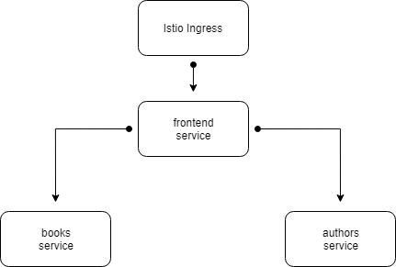
Demo Application

Slide 4
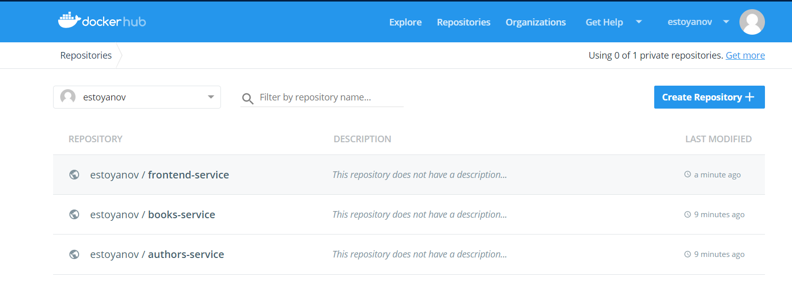
Docker Hub - Repositories

Slide 5
Tracing Monitoring Logging

Slide 6
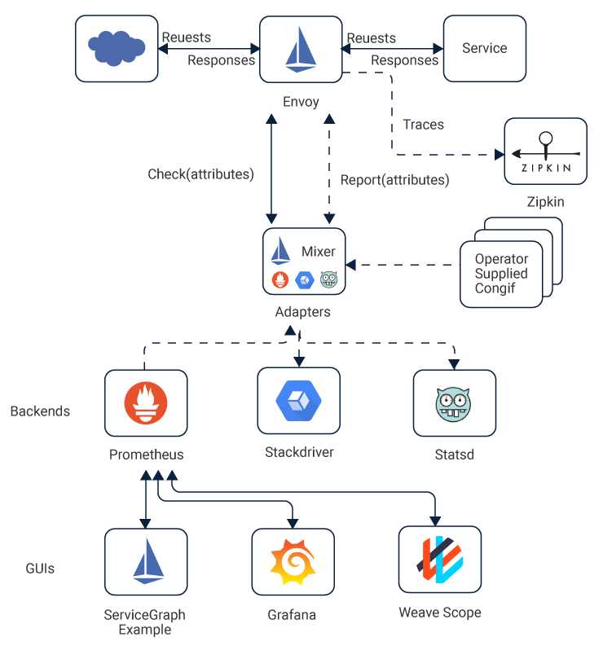
Mixer Architecture

Slide 7
istio tracing
Built-in integrations
Zipkin
Jaegar
LightStep

Slide 8
istio tracing
Application should propagate trace context via headers.
Trace context should suite the OpenTracing protocol.
Trace context propagation:
x-request-id
x-b3-traceid
x-b3-spanid
x-b3-parentspanid
x-b3-sampled
x-b3-flags
x-ot-span-context

Slide 9
Metrics and logs
Instance configuration – tells mixer component how to generate data values.
Handler configuration – responsible for sending incoming data to the destination source.
Rule configuration – directs mixer to which handler data should be sent.

Slide 10
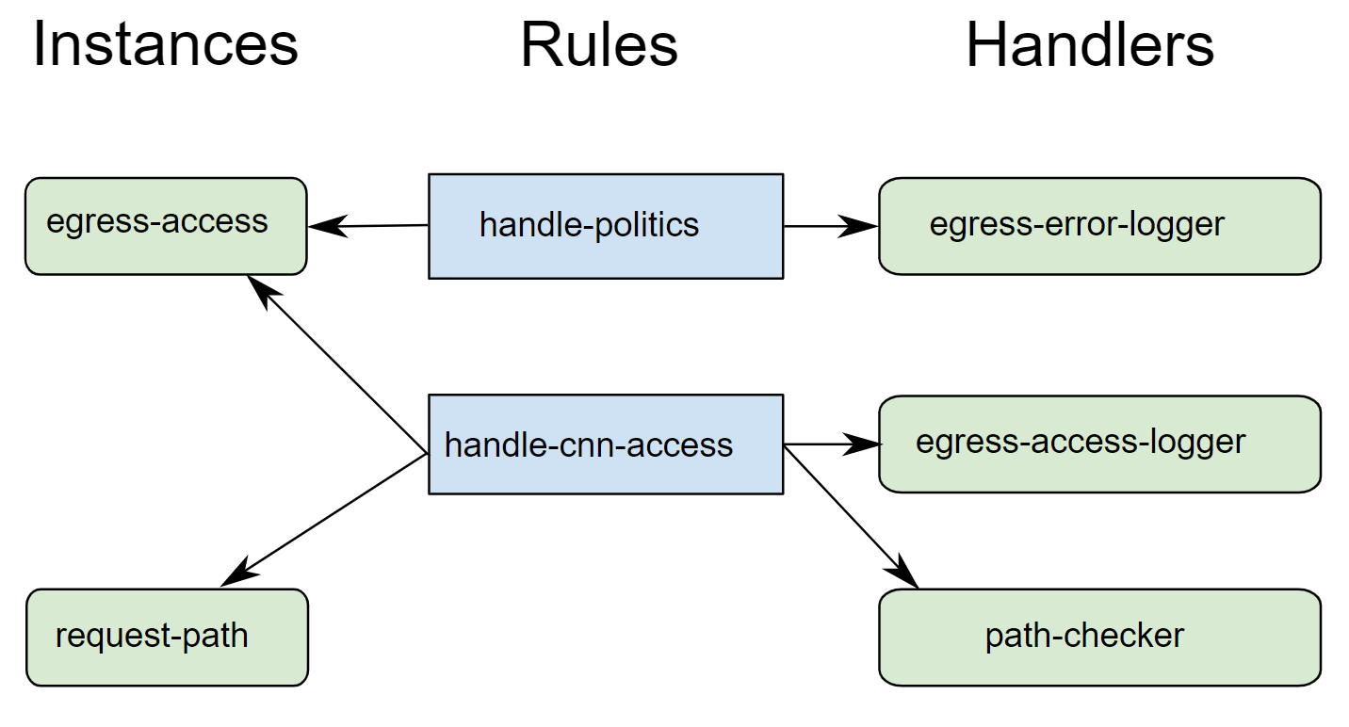
Configuration components example

Slide 11
Visualization

Slide 12
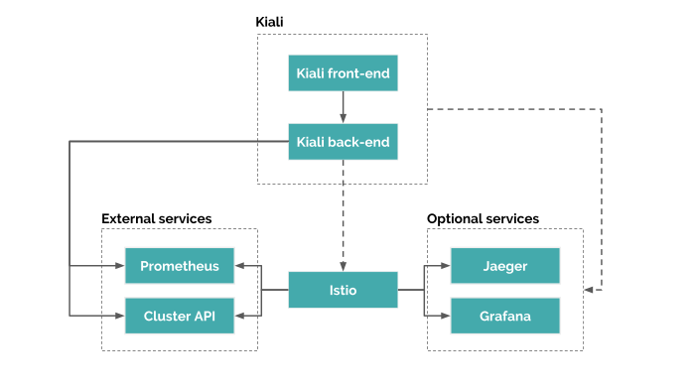
Kiali Architecture

Slide 13
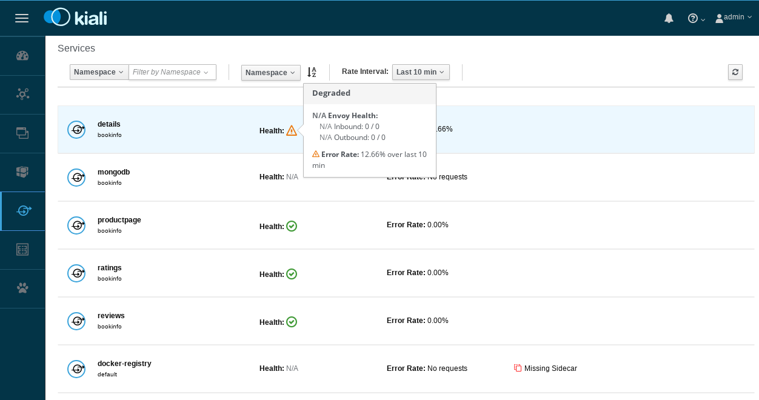
Kiali visualization

Slide 14
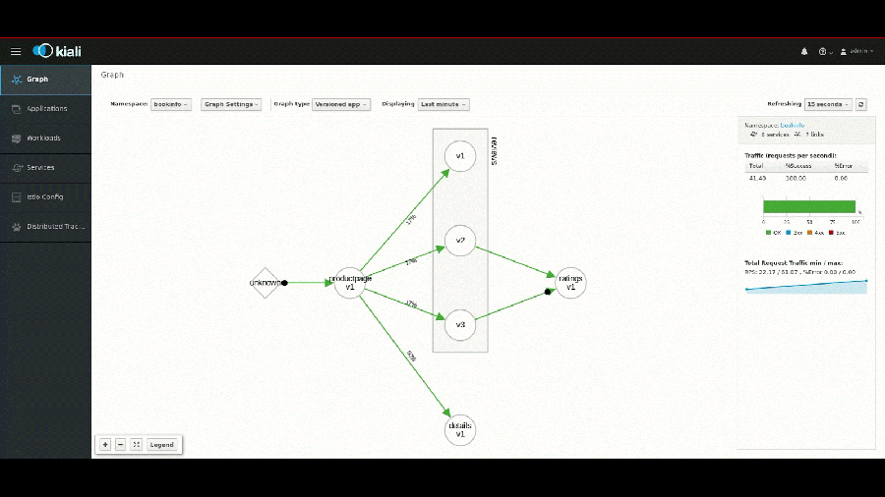
Kiali visualization

Slide 15

Questions?

Slide 16
Homework
Task: istio configuration
Instructions: in attachments
Demo project: in attachments

